Slide 1
Robotics and AI Department
ETHAR ABDULAZIZ MOHAMEED ALZAHRANI

Slide 2

INTRODUCTION
Robots have become a topic of great interest nowadays. In our imagination, a robot is a machine that looks and behaves like a human being. Robots are, in fact, defined as human-made mechanical devices that can move on their own, their movement must be designed, planned, sensed, pushed and controlled, and their kinetic behavior can be influenced by “programming”.

Slide 3
—STEVE JOBS
“Your time is limited, so don’t waste it living someone else’s life.”

Slide 4
01
03
02
04
Download VirtualBox
Install ROS Melodic
Install Ubuntu
Install arm package on system ROS Melodic

Slide 5
01
Download VirtualBox

Slide 6

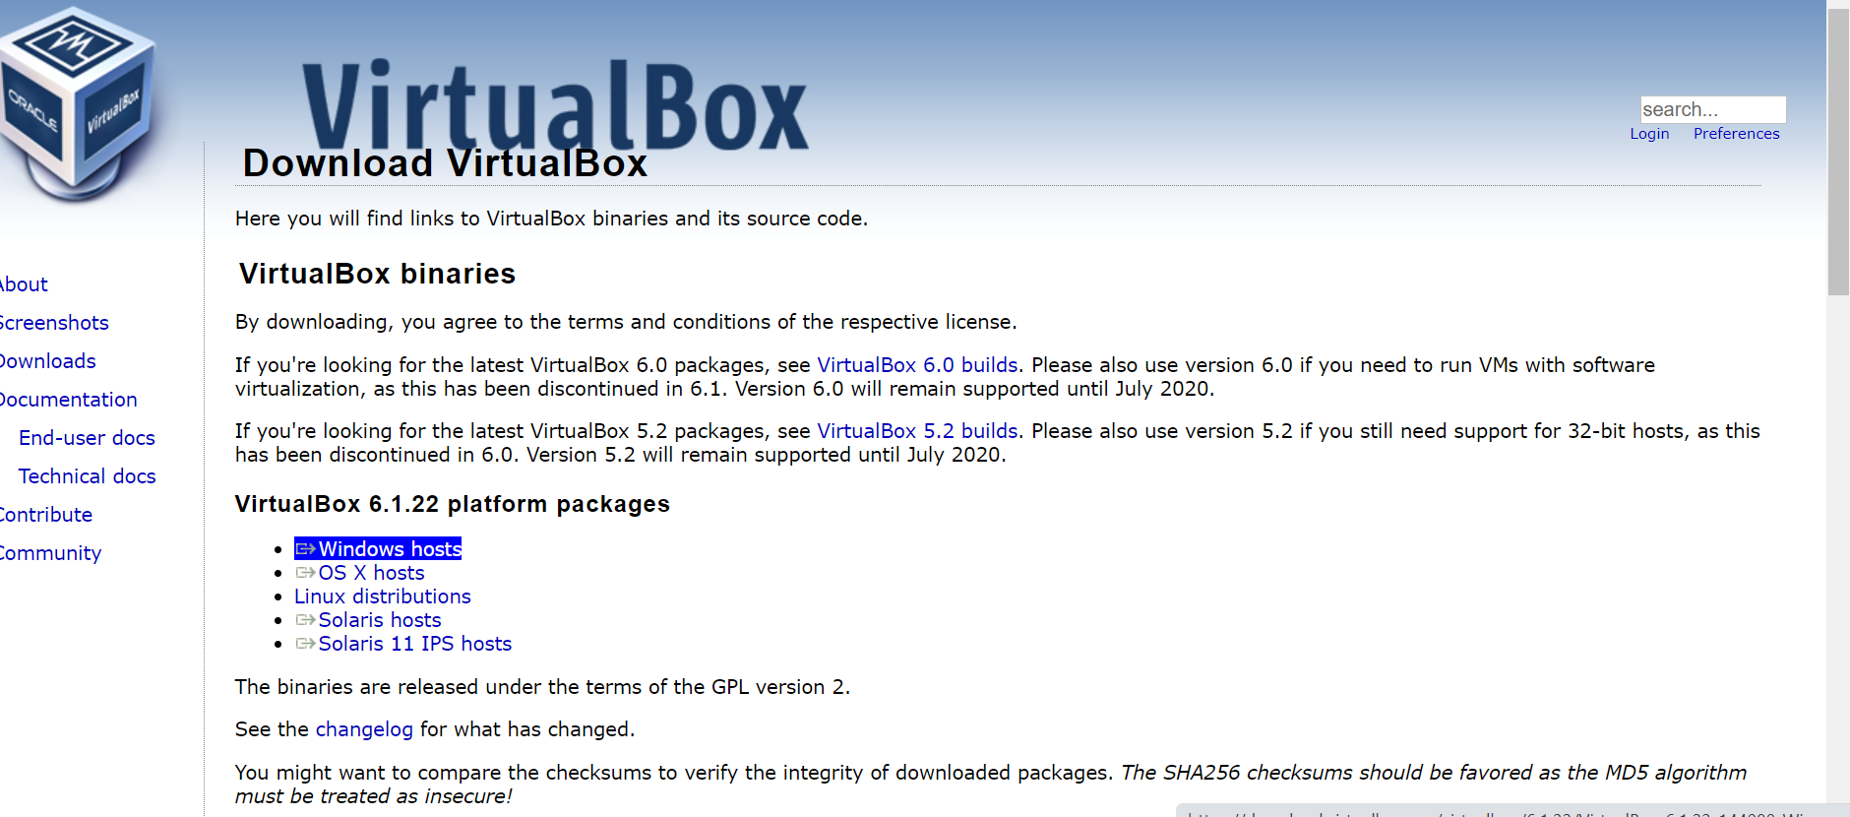

Download VirtualBox
Open the link and choose windows hosts, then the download will be done directly
https://www.virtualbox.org/wiki/Downloads

Slide 7
02
Install Ubuntu

Slide 8
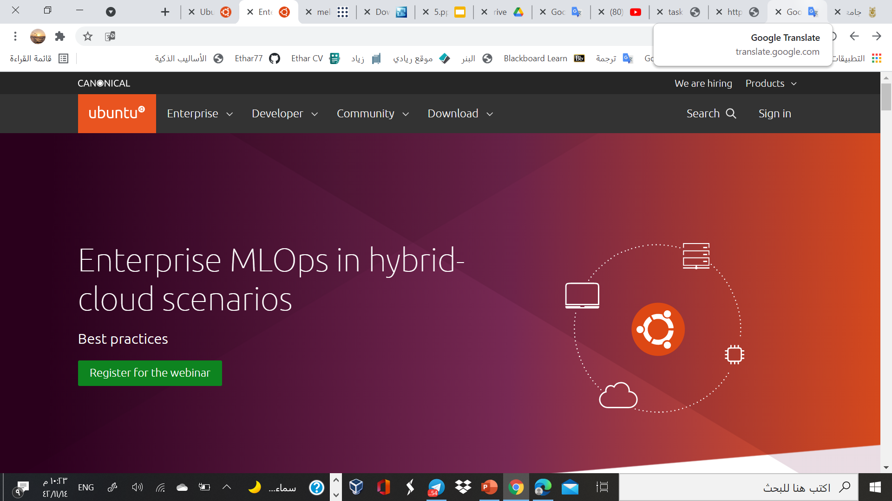
Install Ubuntu

Slide 9
Kind of Ubuntu
16.04
18.04
20.04
With ROS kinetic
With ROS melodic
With ROS noetic

Slide 10
18.04
I chose Ubuntu 18.04 because I will be downloading the Ros melodic
https://releases.ubuntu.com/18.04/

Slide 11
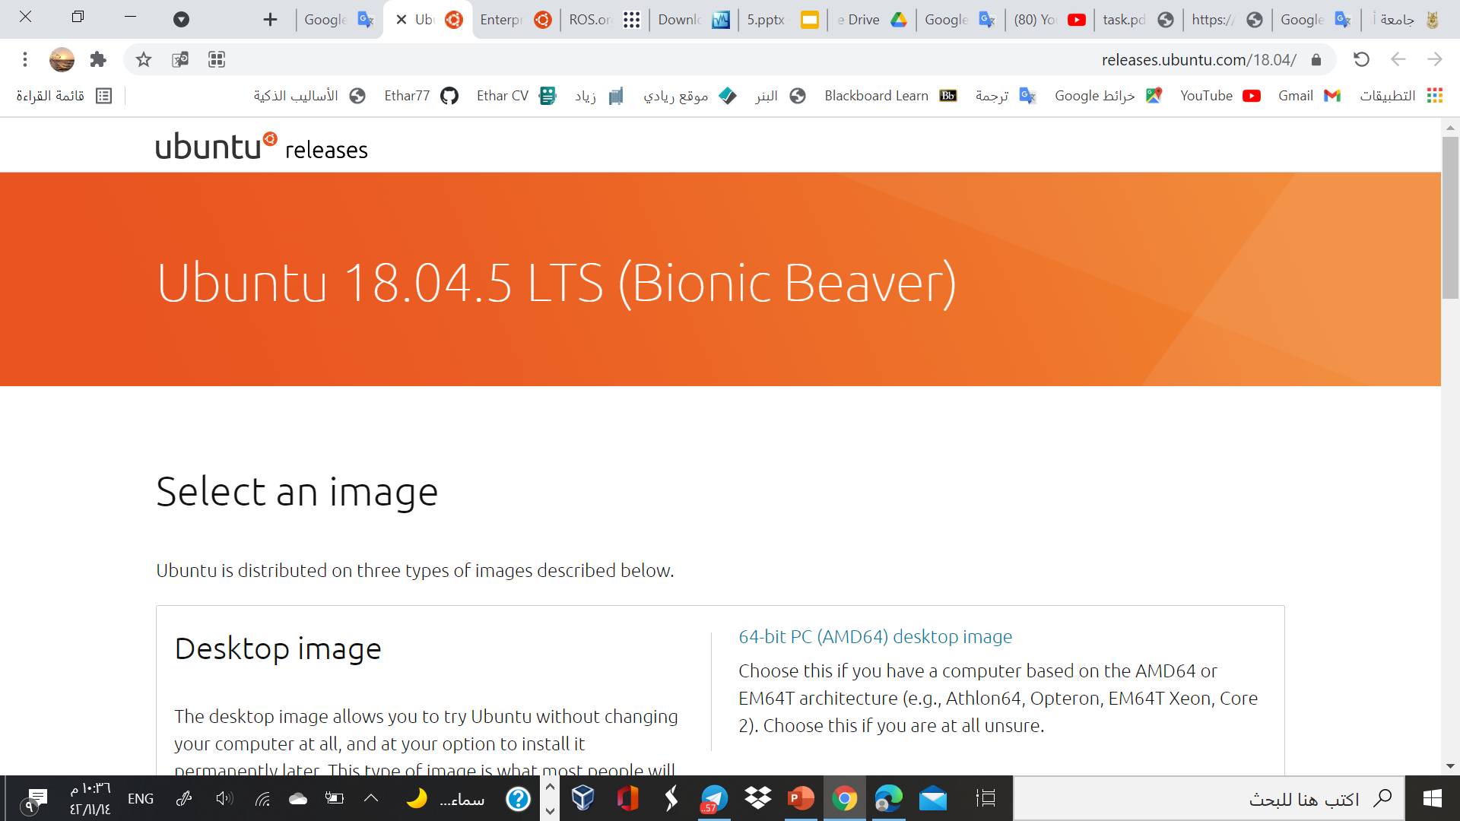
This is the home page for Ubuntu 18.04, just scroll down

Slide 12
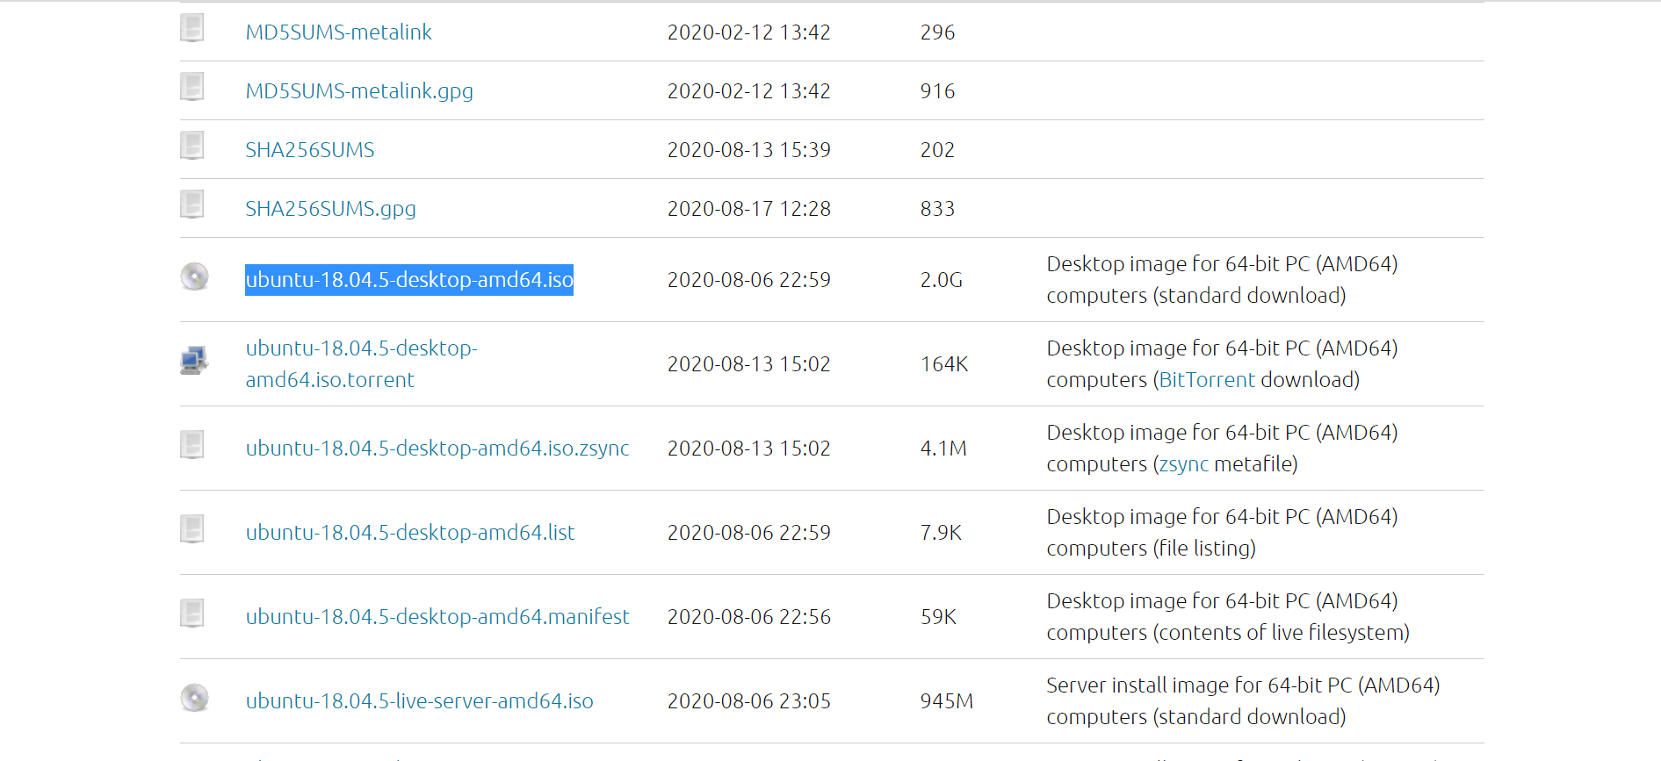
Click on the link and it will download

Slide 13
Now we have “VirtualBox” and “Ubuntu 18.04”

Slide 14
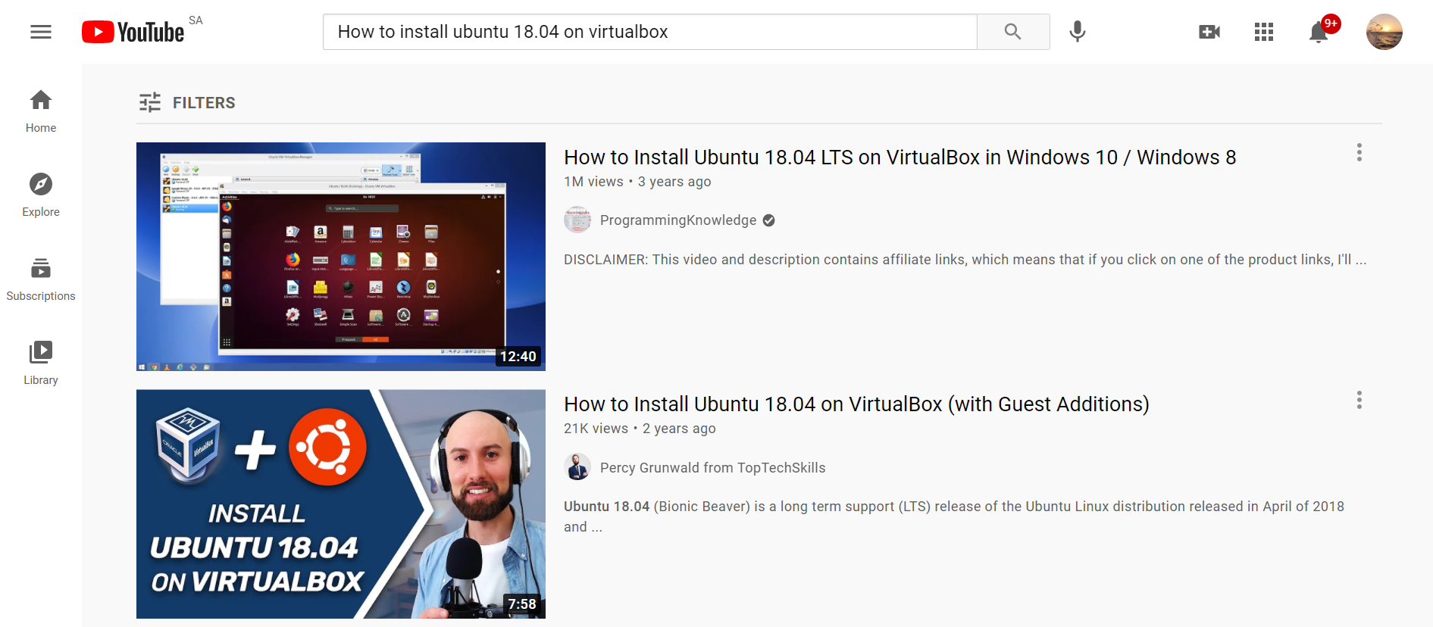
We install Ubuntu on VirtualBox
At this point, I went to YouTube and searched about “How to install ubuntu 18.04 on VirtualBox”

Slide 15
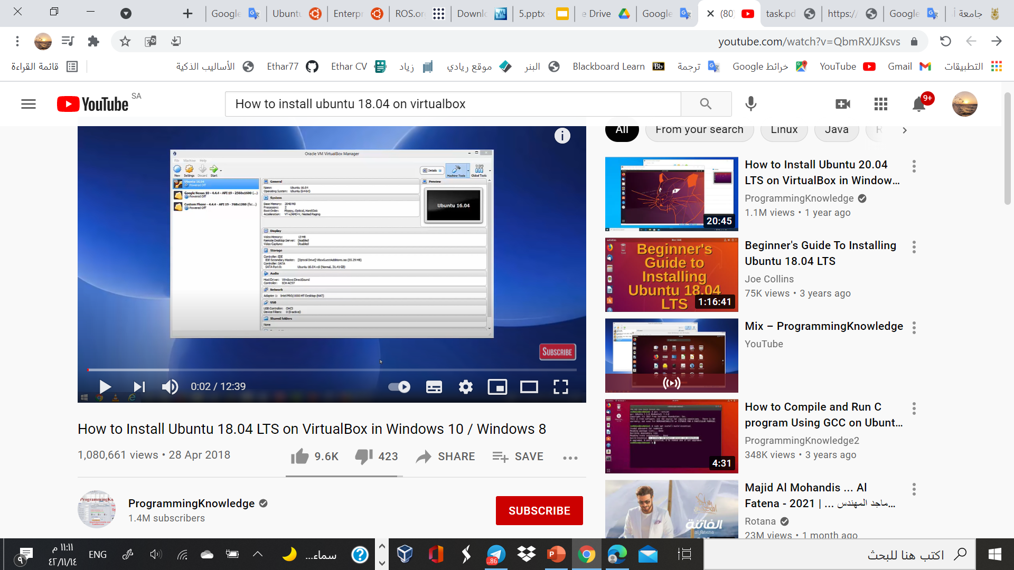
https://youtu.be/QbmRXJJKsvs
This video helped me , I recommend it

Slide 16
03
Install ROS Melodic

Slide 17


What is ROS?
The Robot Operating System (ROS) is a set of software libraries and tools that help you build robot applications. From drivers to state-of-the-art algorithms, and with powerful developer tools, ROS has what you need for your next robotics project. And it's all open source.

Slide 18
How to install ROS Melodic
sudo sh -c 'echo "deb http://packages.ros.org/ros/ubuntu $(lsb_release -sc) main" > /etc/apt/sources.list.d/ros-latest.list’
sudo apt-key adv --keyserver 'hkp://keyserver.ubuntu.com:80' --recv-key C1CF6E31E6BADE8868B172B4F42ED6FBAB17C654
sudo apt update
sudo apt install ros-melodic-desktop-full
apt search ros-melodic
echo "source /opt/ros/melodic/setup.bash" >> ~/.bashrc
source ~/.bashrc
sudo apt install python-rosdep python-rosinstall python-rosinstall-generator python-wstool build-essential
sudo apt install python-rosdep
sudo rosdep init
rosdep update

Slide 19
How to install ROS Melodic
sudo apt-get install ros-noetic-catkin
mkdir -p ~/catkin_ws/src
cd ~/catkin_ws/
catkin_make
cd ~/catkin_ws/src
git clone https://github.com/smart-methods/arduino_robot_arm.git
cd ~/catkin_ws
rosdep install --from-paths src --ignore-src -r -y
sudo apt-get install ros-kinetic-moveit
sudo apt-get install ros-kinetic-joint-state-publisher ros-kinetic-joint-state-publisher-gui
sudo apt-get install ros-kinetic-gazebo-ros-control joint-state-publisher
sudo apt-get install ros-kinetic-ros-controllers ros-kinetic-ros-control
sudo nano ~/.bashrc
JUST COPY (ctrl+c) and PASTE (ctrl+v) in Terminal

Slide 20

To start the ROS (master node) $ roscore

Slide 21
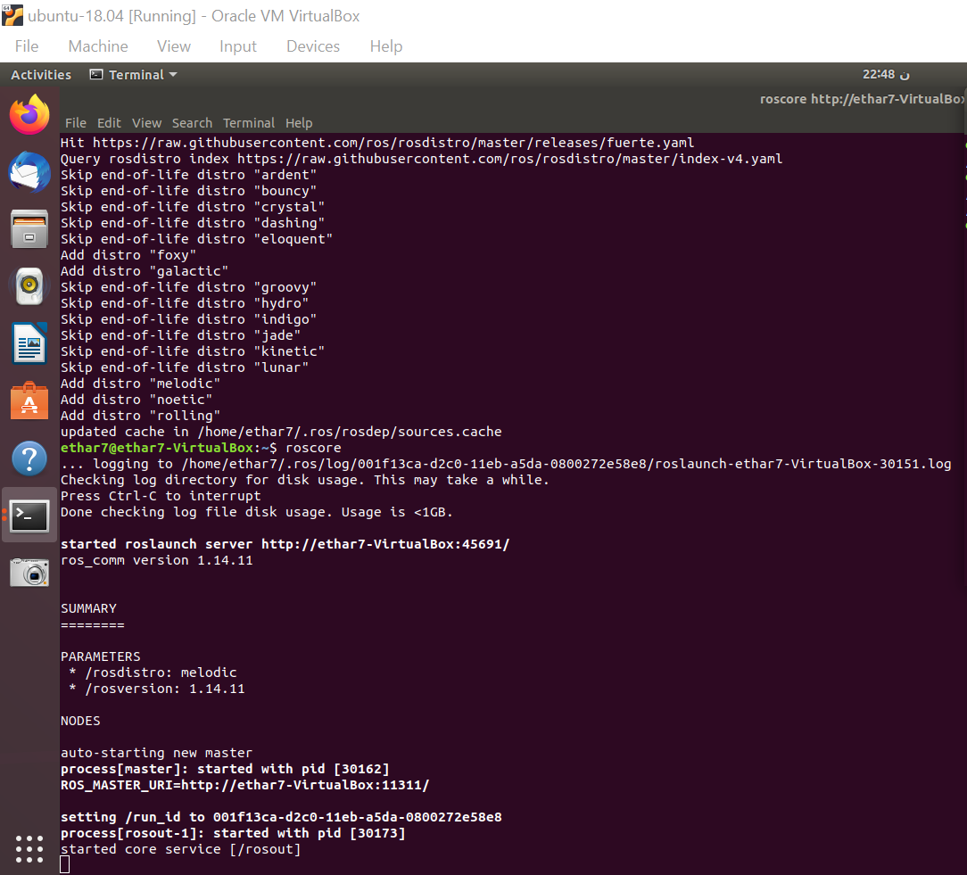
When I was installing the ROS

Slide 22
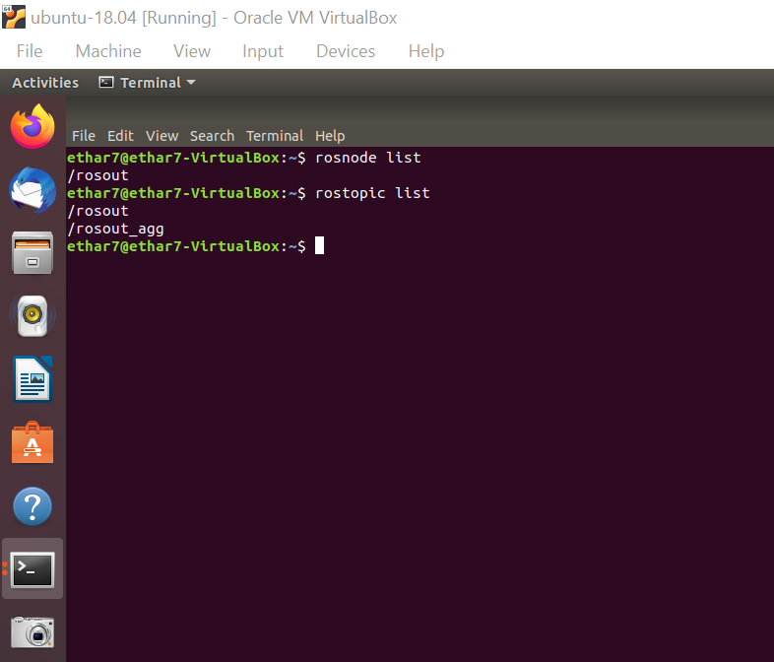
Start the ROS

Slide 23

Installing the package arduino_robot_arm

Slide 24

Package Arduino robot arm
Add the “arduino_robot_arm” package to “src” folder :
$ cd ~/catkin_ws/src
$ sudo apt install git
$ git clone https://github.com/smart-methods/arduino_robot_arm
Install all the dependencies :
$ cd ~/catkin_ws
$ rosdep install --from-paths src --ignore-src -r -y
$ sudo apt-get install ros-melodic-moveit
$ sudo apt-get install ros-melodic-joint-state-publisher ros-melodic-joint-state-publisher-gui
$ sudo apt-get install ros-melodic-gazebo-ros-control joint-state-publisher
$ sudo apt-get install ros-melodic-ros-controllers ros-melodic-ros-control
Compile the package
$ catkin_make
JUST COPY (ctrl+c) and PASTE (ctrl+v) in Terminal

Slide 25
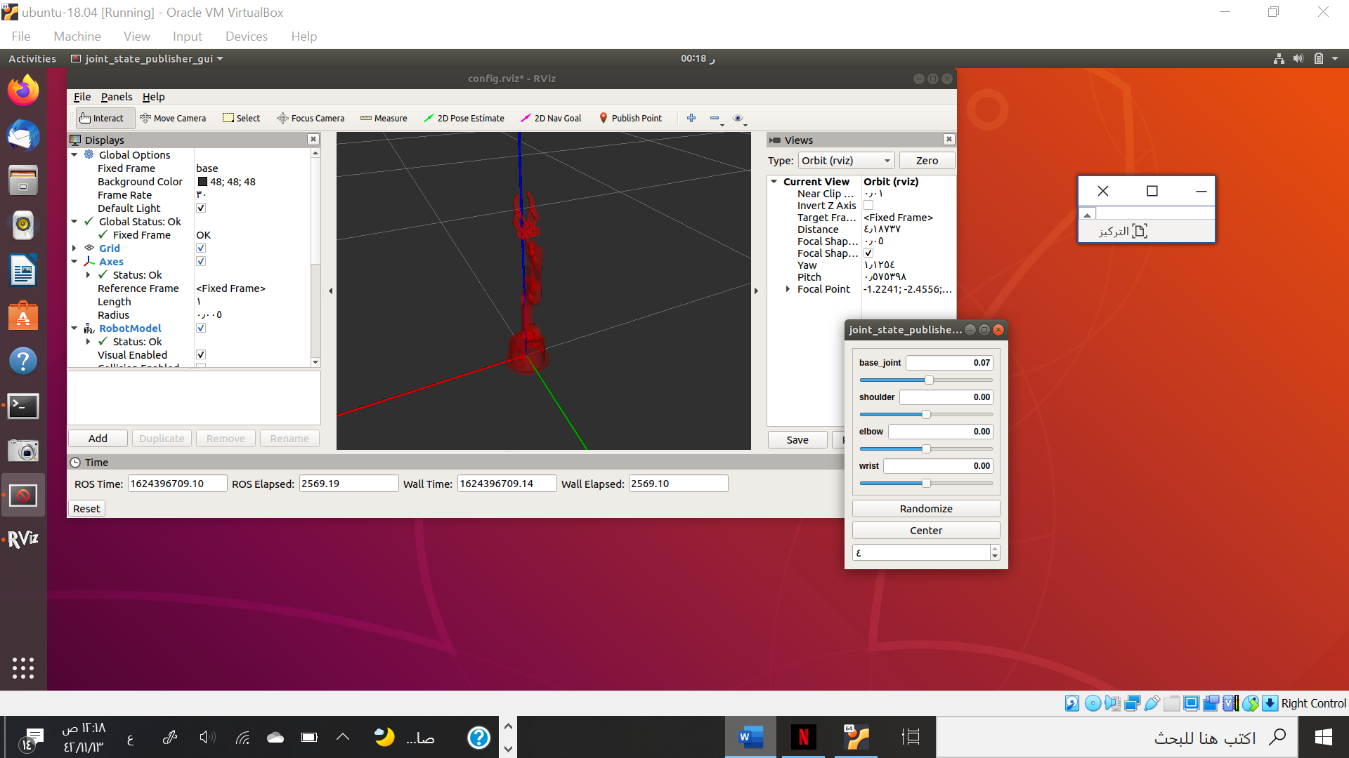
Package Arduino robot arm
$ roslaunch robot_arm_pkg check_motors.launch

Slide 26
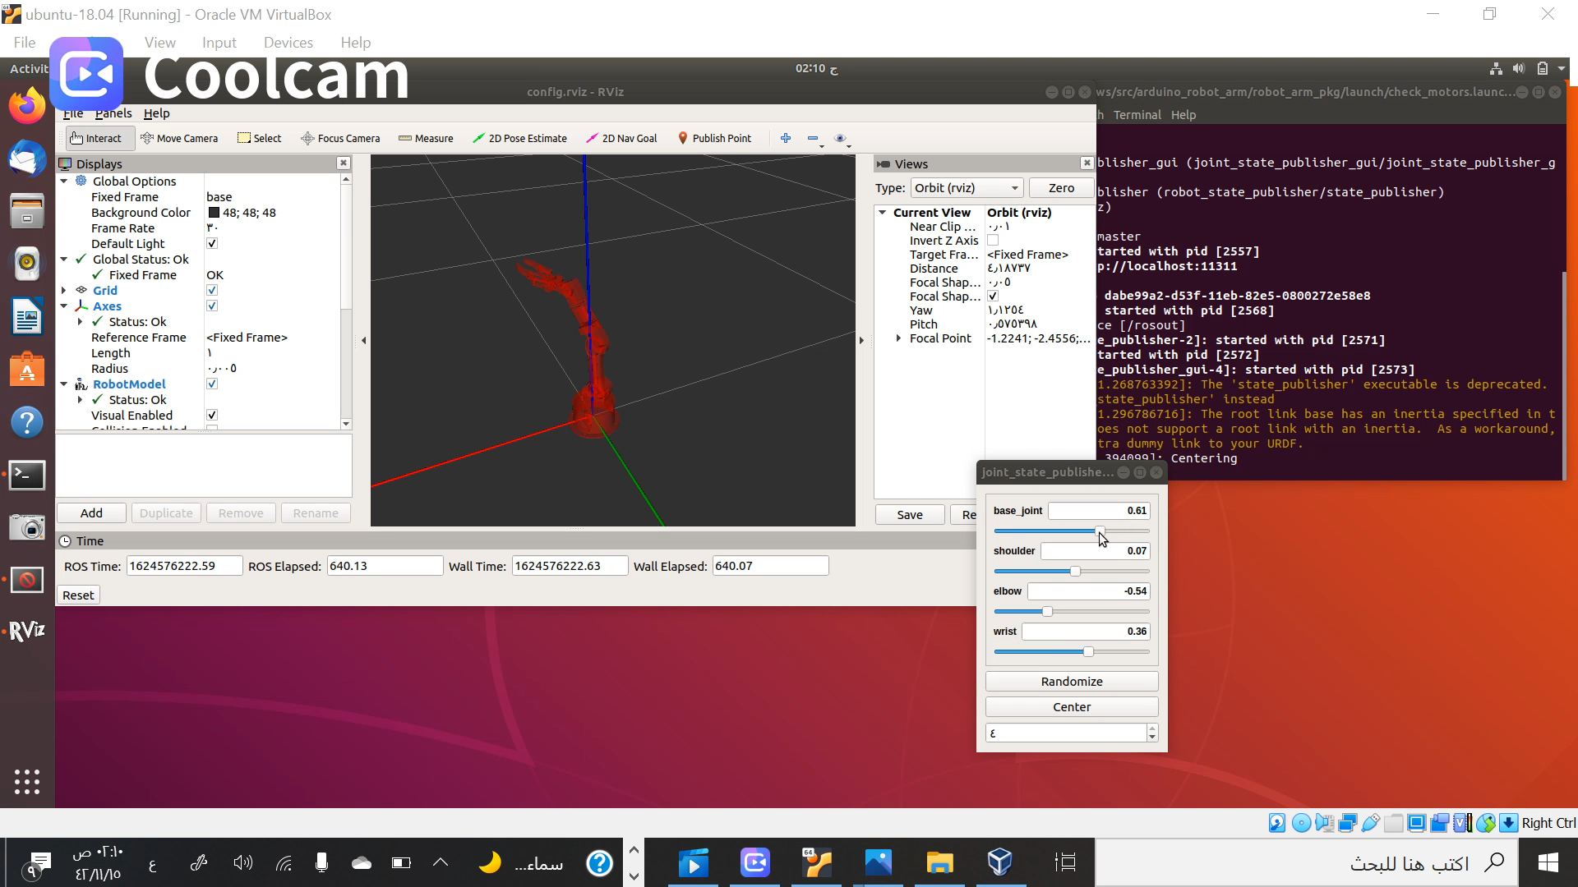
In this video, the Package arm is work

Slide 27
THANK YOU!
for giving me your time to watch the show.
I hope you enjoy.

